Slide 1
Chapter 7: Transport Layer
Introduction to Networking
Notes:
Cisco Networking Academy program
Introduction to Networking
Chapter 7

Slide 2
Chapter Outline
7.0 Introduction
7.1 Transport Layer Protocols
7.2 TCP and UDP
7.3 Summary

Slide 3
Section 7.1: Transport Layer Protocols
Upon completion of this section, you should be able to:
Describe the purpose of the transport layer in managing the transportation of data in end-to-end communication.
Describe characteristics of the TCP and UDP protocols, including port numbers and their uses.

Slide 4
Topic 7.1.1: Transportation of Data

Slide 5
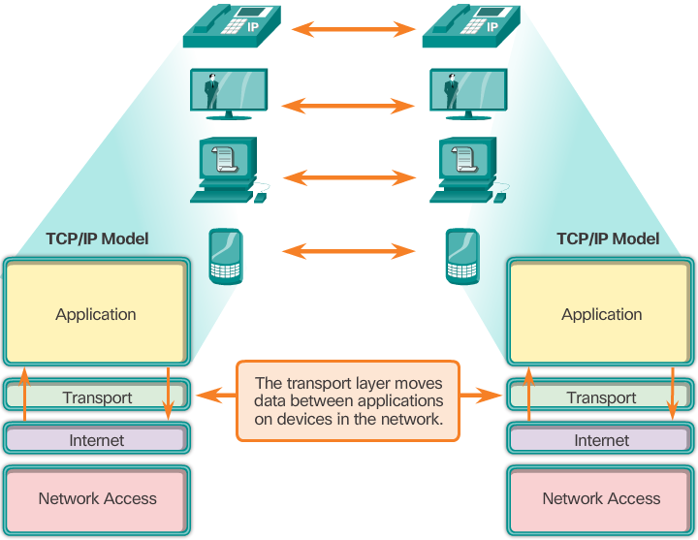
Role of the Transport Layer
The transport layer is responsible for establishing a temporary communication session between two applications and delivering data between them.
The transport layer provides services, such as:
Connection-oriented data stream support
Reliability
Flow control
Multiplexing
Notes:
9.1.1.1 Role of the Transport Layer

Slide 6
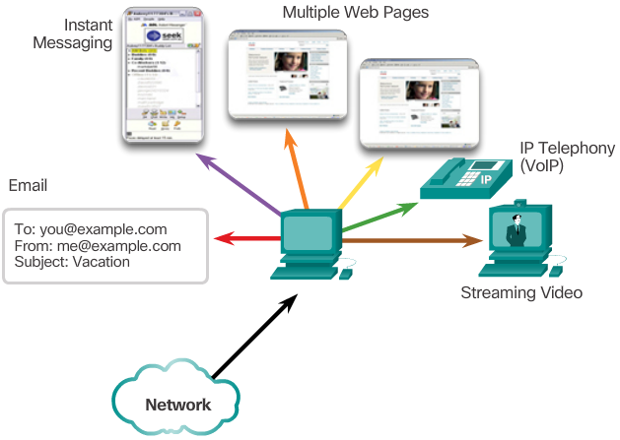
Transport Layer Responsibilities
Track Individual Conversations
By tracking each individual conversation flowing between a source application and a destination application separately.
Notes:
9.1.1.2 Transport Layer Responsibilities

Slide 7
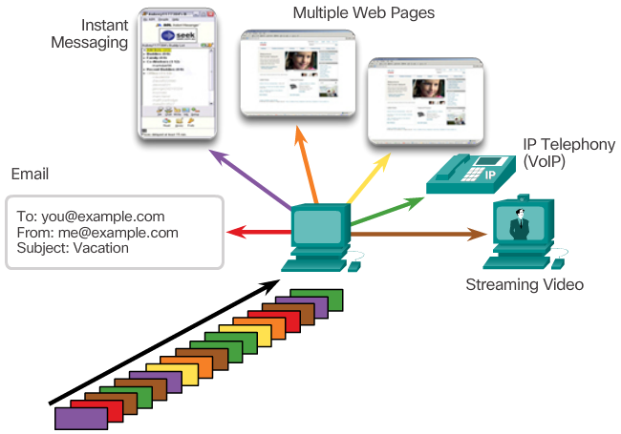
Transport Layer Responsibilities (cont.)
Segment Data and Reassemble Segments
By dividing the data into segments that are easier to manage and transport.
Notes:
9.1.1.2 Transport Layer Responsibilities

Slide 8
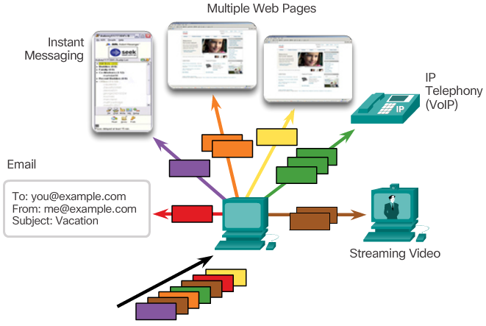
Transport Layer Responsibilities (cont.)
Identify the Applications
By ensuring even when multiple applications are running on a device, all applications receive the correct data.
Notes:
9.1.1.2 Transport Layer Responsibilities

Slide 9
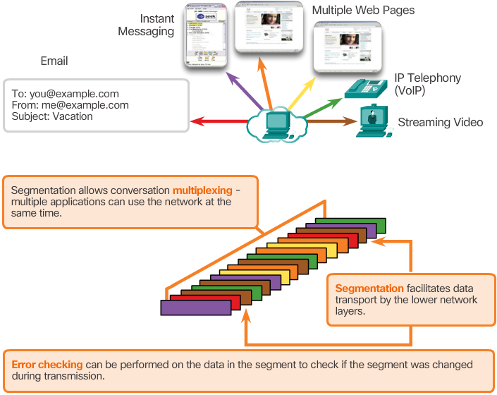
Conversation Multiplexing
Segmenting the data into smaller chunks enables many different communications, from many different users, to be interleaved (multiplexed) on the same network.
The transport layer adds a header that contains binary data to identify each segment of data and to enable various transport layer protocols to perform different functions in the management of data communication.
Notes:
9.1.1.3 Conversation Multiplexing

Slide 10
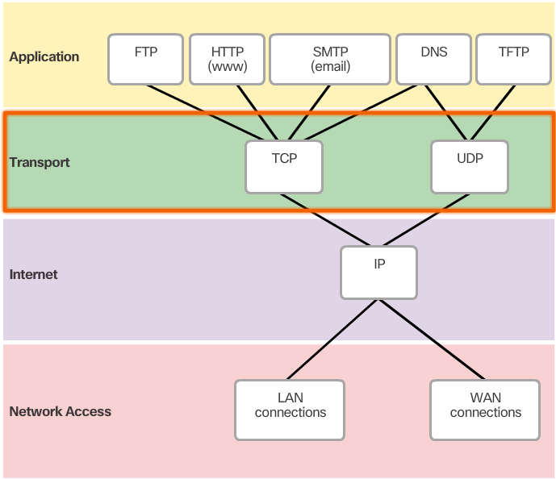
Transport Layer Reliability
The transport layer is also responsible for managing reliability.
Some applications may not require reliability. Transport layer requirements vary from application to application.
TCP/IP suite provides two transport layer protocols, Transmission Control Protocol (TCP) and User Datagram Protocol (UDP).
IP uses these transport protocols to enable hosts to communicate and transfer data.
TCP is considered a reliable, full-featured transport layer protocol, which allows for packet data delivery confirmation.
In contrast, UDP is a very simple transport layer protocol that does not provide any reliability.
Notes:
9.1.1.4 Transport Layer Reliability

Slide 11
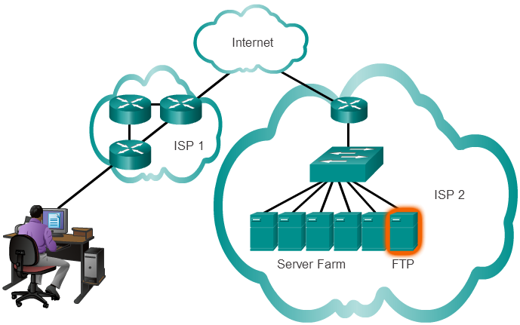
TCP
TCP transport is reliable because it supports packet delivery confirmation.
There are three basic operations that enable reliability with TCP:
Numbering and tracking data segments transmitted to a specific host from a specific application
Acknowledging received data
Retransmitting any unacknowledged data after a certain period of time
Notes:
9.1.1.5 TCP

Slide 12
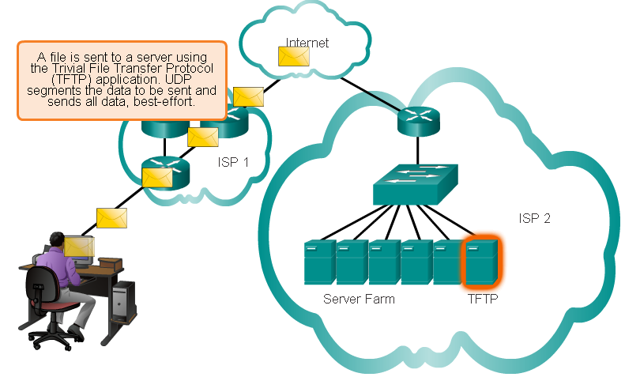
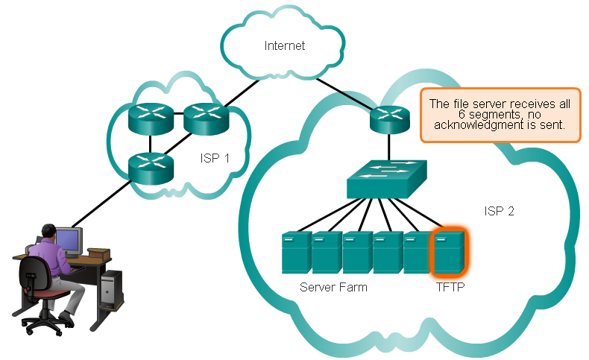
UDP
Some applications do not require reliability. Reliability incurs additional overhead and possible delays in transmission.
Adding overhead to ensure reliability for some applications could reduce the usefulness of the application and can even be detrimental.
If reliability is not required, UDP is a better transport protocol.
UDP provides the basic functions for delivering data segments between the appropriate applications, with very little overhead and data checking.
Notes:
9.1.1.6 UDP

Slide 13
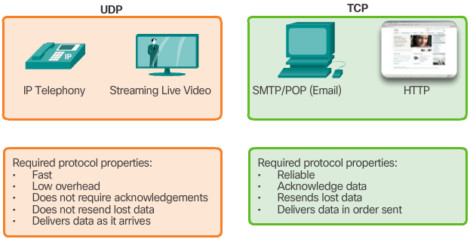
Transport Layer Protocols
TCP is a better choice for:
Applications whose segments must arrive in a very specific sequence to be processed successfully.
Application in which all data must be fully received before any is considered useful.
Applications requiring TCP include: Databases, Web browsers, Email clients.
UDP is a better choice for applications that can tolerate some data loss during transmission, but delays in transmission are unacceptable.
Applications using UDP include:
Live audio streaming
live video streaming
Voice over IP (VoIP)
Notes:
9.1.1.7 Transport Layer Protocols

Slide 14
Topic 7.1.2: TCP and UDP Overview

Slide 15
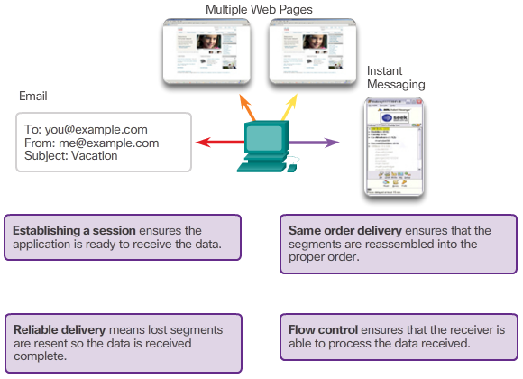
TCP Features
In addition to supporting the basic functions of data segmentation and reassembly, TCP provides the following services:
Establishing a Session
Reliable Delivery
Same-Order Delivery
Flow Control
Notes:
9.1.2.1 TCP Features
Establishing a Session
TCP is a connection-oriented protocol. A connection-oriented protocol is one that negotiates and establishes a permanent connection (or session) between source and destination devices prior to forwarding any traffic. Through session establishment, the devices negotiate the amount of traffic that can be forwarded at a given time, and the communication data between the two can be closely managed.
Reliable Delivery
In networking terms, reliability means ensuring that each segment that the source sends arrives at the destination. For many reasons, it is possible for a segment to become corrupted or lost completely, as it is transmitted over the network.
Same-Order Delivery
Because networks may provide multiple routes that can have different transmission rates, data can arrive in the wrong order. By numbering and sequencing the segments, TCP can ensure that these segments are reassembled into the proper order.
Flow Control
Network hosts have limited resources, such as memory and processing power. When TCP is aware that these resources are overtaxed, it can request that the sending application reduce the rate of data flow. This is done by TCP regulating the amount of data the source transmits. Flow control can prevent the need for retransmission of the data when the receiving host's recourses are overwhelmed.
For more information on TCP, read the RFC.

Slide 16
TCP Features
Establishing a Session
TCP is a connection-oriented protocol. A connection-oriented protocol is one that negotiates and establishes a permanent connection (or session) between source and destination devices prior to forwarding any traffic. Through session establishment, the devices negotiate the amount of traffic that can be forwarded at a given time, and the communication data between the two can be closely managed.
Reliable Delivery
In networking terms, reliability means ensuring that each segment that the source sends arrives at the destination. For many reasons, it is possible for a segment to become corrupted or lost completely, as it is transmitted over the network.
Same-Order Delivery
Because networks may provide multiple routes that can have different transmission rates, data can arrive in the wrong order. By numbering and sequencing the segments, TCP can ensure that these segments are reassembled into the proper order.
Flow Control
Network hosts have limited resources, such as memory and processing power. When TCP is aware that these resources are overtaxed, it can request that the sending application reduce the rate of data flow. This is done by TCP regulating the amount of data the source transmits. Flow control can prevent the need for retransmission of the data when the receiving host's recourses are overwhelmed.

Slide 17
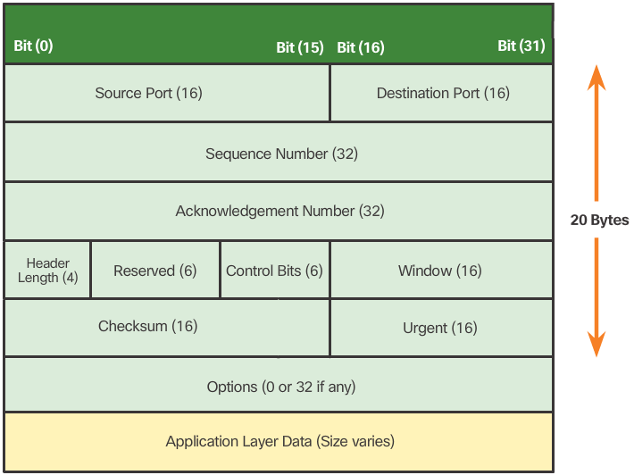
TCP Header
TCP is a stateful protocol. It keeps track of the state of the communication session by recording which information it has sent and which information has been acknowledged.
Each TCP segment has 20 bytes of overhead in the header encapsulating the application layer data, as shown in this image.
Notes:
9.1.2.2 TCP Header
Source Port (16 bits) and Destination Port (16 bits) - Used to identify the application.
Sequence number (32 bits) - Used for data reassembly purposes.
Acknowledgement number (32 bits) - Indicates the data that has been received.
Header length (4 bits) - Known as ʺdata offsetʺ. Indicates the length of the TCP segment header.
Reserved (6 bits) - This field is reserved for the future.
Control bits (6 bits) - Includes bit codes, or flags, which indicate the purpose and function of the TCP segment.
Window size (16 bits) - Indicates the number of bytes that can be accepted at one time.
Checksum (16 bits) - Used for error checking of the segment header and data.
Urgent (16 bits) - Indicates if data is urgent.

Slide 18
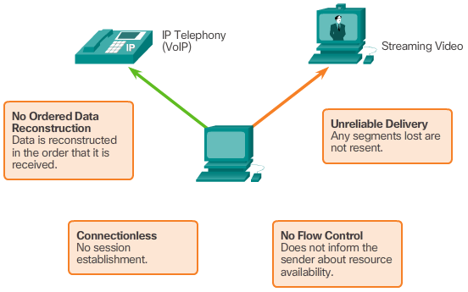
UDP Features
Notes:
9.1.2.3 UDP Features

Slide 19
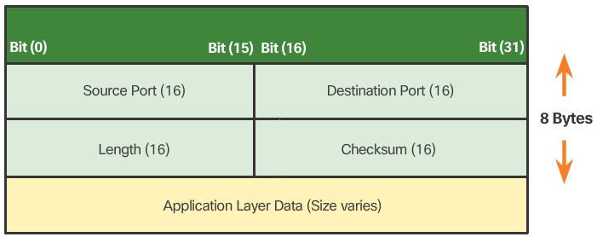
UDP Header
UDP is a stateless protocol. Neither the sender or the receiver is obligated to keep track of the state of the communication session.
Reliability must be handled by the application.
Live video and voice applications must quickly deliver data and can tolerate some data loss; they are perfectly suited to UDP.
The pieces of communication in UDP are called datagrams.
These datagrams are sent as best-effort by the transport layer protocol.
UDP has a low overhead of 8 bytes.
Notes:
9.1.2.4 UDP Header

Slide 20
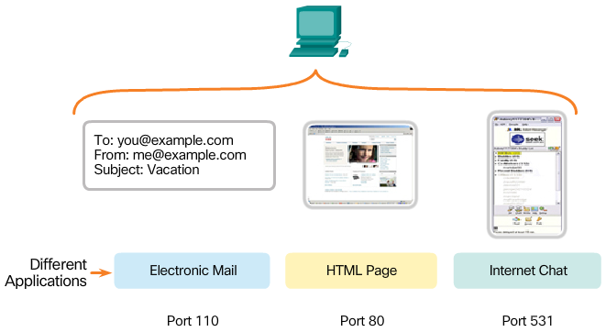
Multiple Separate Conversations
The transport layer must separate and manage multiple communications with different transport requirements.
Different applications are sending and receiving data over the network simultaneously.
Unique header values allow TCP and UDP to manage these multiple and simultaneous conversations by identifying these applications.
These unique identifiers are the port numbers.
Notes:
9.1.2.5 Multiple Separate Conversations

Slide 21
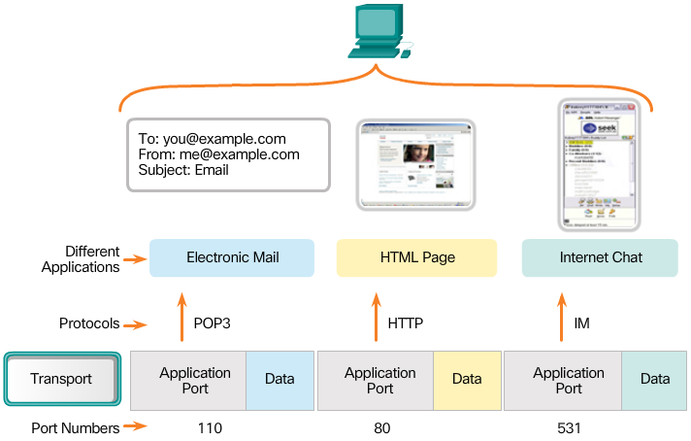
Port Numbers
Source Port
The source port number is dynamically chosen by the sending device to identify a conversation between two devices.
An HTTP client usually sends multiple HTTP requests to a web server at the same time. Each separate HTTP conversation is tracked based on the source ports.
Destination Port
Used to identify an application or service running in the server.
A server can offer more than one service at the same time, offering a web service on port 80 and FTP on port 21 simultaneously.
Notes:
9.1.2.6 Port Numbers

Slide 22
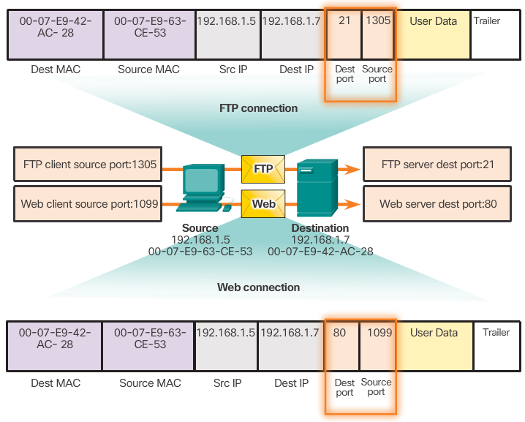
Socket Pairs
The combination of the source IP address and source port number, or the destination IP address and destination port number, is known as a socket.
The socket is used to identify the server and service being requested by the client.
Two sockets combine to form a socket pair: (192.168.1.5:1099, 192.168.1.7:80)
Sockets enable multiple processes running on a client and multiple connections to a server process to be distinguished from each other.
The source port number acts as a return address for the requesting application.
It is the transport layer’s job to keeps track of active sockets.
Notes:
9.1.2.7 Socket Pairs

Slide 23
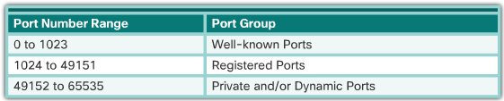
Port Number Groups
The Internet Assigned Numbers Authority (IANA) is the standards body responsible for assigning various addressing standards, including port numbers.
Port Numbers
Well-known Ports (Numbers 0 to 1023) - These numbers are reserved for services and applications. They are commonly used for applications such as web browsers, email clients, and remote access. By defining these well-known ports for server applications, client applications can be programmed to request a connection to that specific port and its associated service.
Notes:
9.1.2.8 Port Number Groups
Well-known Ports (Numbers 0 to 1023) - These numbers are reserved for services and applications. They are commonly used for applications such as web browsers, email clients, and remote access. By defining these well-known ports for server applications, client applications can be programmed to request a connection to that specific port and its associated service.
Registered Ports (Numbers 1024 to 49151) - These port numbers are assigned by IANA to a requesting entity to use with specific processes or applications. These processes are primarily individual applications that a user has chosen to install, rather than common applications that would receive a well-known port number. For example, Cisco has registered port 1985 for its Hot Standby Routing Protocol (HSRP) process.
Dynamic or Private Ports (Numbers 49152 to 65535) - Also known as ephemeral ports, these are usually assigned dynamically by the client’s OS when a connection to a service is initiated. The dynamic port is then used to identify the client application during communication.
Figure 2 displays some common well-known port numbers and their associated applications. Some applications may use both TCP and UDP. For example, DNS uses UDP when clients send requests to a DNS server. However, communication between two DNS servers always uses TCP.

Slide 24
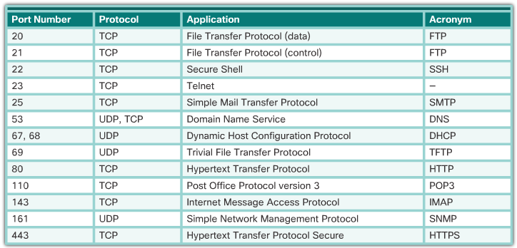
Port Number Groups
Well-Known Port Numbers
Notes:
9.1.2.8 Port Number Groups
Well-known Ports (Numbers 0 to 1023) - These numbers are reserved for services and applications. They are commonly used for applications such as web browsers, email clients, and remote access. By defining these well-known ports for server applications, client applications can be programmed to request a connection to that specific port and its associated service.
Registered Ports (Numbers 1024 to 49151) - These port numbers are assigned by IANA to a requesting entity to use with specific processes or applications. These processes are primarily individual applications that a user has chosen to install, rather than common applications that would receive a well-known port number. For example, Cisco has registered port 1985 for its Hot Standby Routing Protocol (HSRP) process.
Dynamic or Private Ports (Numbers 49152 to 65535) - Also known as ephemeral ports, these are usually assigned dynamically by the client’s OS when a connection to a service is initiated. The dynamic port is then used to identify the client application during communication.
Figure 2 displays some common well-known port numbers and their associated applications. Some applications may use both TCP and UDP. For example, DNS uses UDP when clients send requests to a DNS server. However, communication between two DNS servers always uses TCP.

Slide 25
Port Number Groups
Registered Ports (Numbers 1024 to 49151) - These port numbers are assigned by IANA to a requesting entity to use with specific processes or applications. These processes are primarily individual applications that a user has chosen to install, rather than common applications that would receive a well-known port number. For example, Cisco has registered port 1985 for its Hot Standby Routing Protocol (HSRP) process.
Dynamic or Private Ports (Numbers 49152 to 65535) - Also known as ephemeral ports, these are usually assigned dynamically by the client’s OS when a connection to a service is initiated. The dynamic port is then used to identify the client application during communication.
Figure 2 displays some common well-known port numbers and their associated applications. Some applications may use both TCP and UDP. For example, DNS uses UDP when clients send requests to a DNS server. However, communication between two DNS servers always uses TCP.

Slide 26
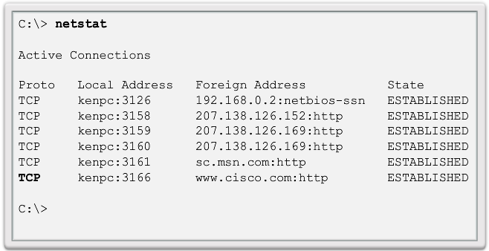
The netstat Command
Unexplained TCP connections can indicate a major security threat.
Netstat is an important network utility that can be used to verify the active connections in a host.
Use netstat to list the protocols in use, the local address and port numbers, the foreign address and port numbers, and the connection state.
By default, the netstat command will attempt to resolve IP addresses to domain names and port numbers to well-known applications.
The -n option can be used to display IP addresses and port numbers in their numerical form.
Notes:
9.1.2.9 The netstat Command
9.1.2.10 Activity – Compare TCP and UDP Characteristics

Slide 27
Section 7.2: TCP and UPD
Upon completion of this section, you should be able to:
Explain how TCP session establishment and termination processes facilitate reliable communication.
Explain how TCP protocol data units are transmitted and acknowledged to guarantee delivery.
Describe the UDP client processes to establish communication with a server.
Compare UDP and TCP.

Slide 28
Topic 7.2.1: TCP Communication Process

Slide 29
TCP Server Processes
Each application process running on the server uses a port number.
An individual server cannot have two services assigned to the same port number within the same transport layer service.
An active server application assigned to a specific port is considered to be open.
Any incoming client request addressed to an open port is accepted and processed by the server application bound to that port.
There can be many ports open simultaneously on a server, one for each active server application.
Notes:
9.2.1.1 TCP Server Processes

Slide 30
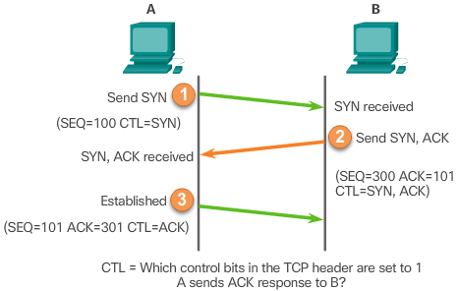
TCP Connection Establishment
A TCP connection is established in three steps:
The initiating client requests a client-to-server communication session with the server.
The server acknowledges the client-to-server communication session and requests a server-to-client communication session.
The initiating client acknowledges the server-to-client communication session.
Notes:
9.2.1.2 TCP Connection Establishment

Slide 31
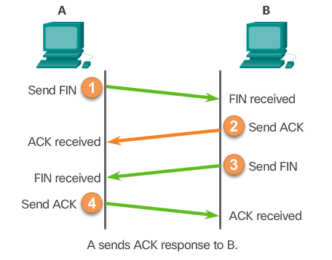
TCP Session Termination
The FIN TCP flag is used to terminate a TCP connection.
When the client has no more data to send in the stream, it sends a segment with the FIN flag set.
The server sends an ACK to acknowledge the receipt of the FIN to terminate the session from client to server.
The server sends a FIN to the client to terminate the server-to-client session.
The client responds with an ACK to acknowledge the FIN from the server.
When all segments have been acknowledged, the session is closed.
Notes:
9.2.1.3 TCP Session Termination

Slide 32
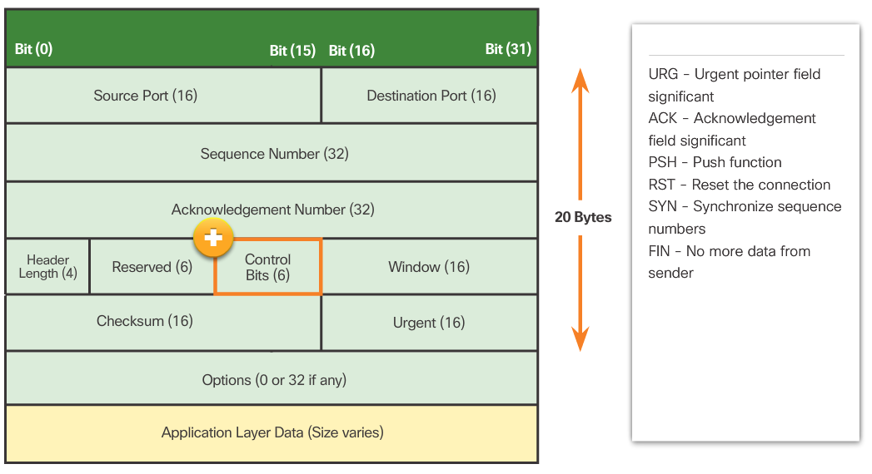
TCP Three-Way Handshake Analysis
The three-way handshake:
Establishes that the destination device is present on the network.
Verifies that the destination device has an active service and is accepting requests on the destination port number that the initiating client intends to use
Informs the destination device that the source client intends to establish a communication session on that port number.
Notes:
9.2.1.4 TCP Three-way Handshake Analysis
9.2.1.5 Video Demonstration – TCP 3-way Handshake
9.2.1.6 Lab – Using Wireshark to Observer the TCP 3-Way Handshake
9.2.1.7 Activity – TCP Connection and Termination Process

Slide 33
TCP Communication TCP Connection, Establishment and Termination
TCP is a connection-oriented protocol
Allows it to set initial values to the window and to initialize sequence number values
TCP uses a process called a three-way handshake to create a new TCP connection
Uses three TCP segments
Three of the TCP flags in the TCP header
SYN flag – Synchronize sequence numbers
ACK flag - Acknowledgement field significant
FIN flag - No more data from sender

Slide 34
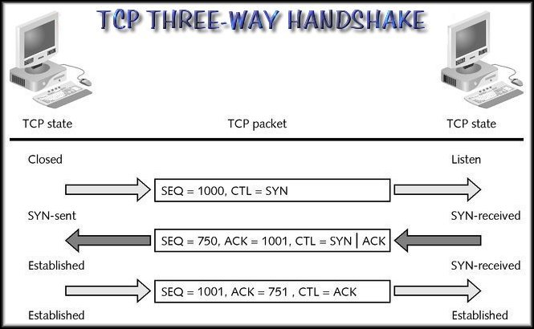
For a connection to be established, the two end stations must synchronize on each other's initial sequence numbers (ISNs).
The ISN is the starting sequence number used when a TCP connection is established.

Slide 35
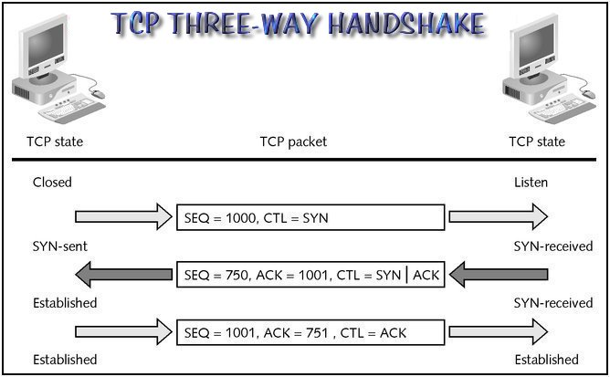
Sequence numbers are used to track the order of segments and to ensure that no segments are lost in transmission.
The Flag fields are used to identify the type of segment.

Slide 36
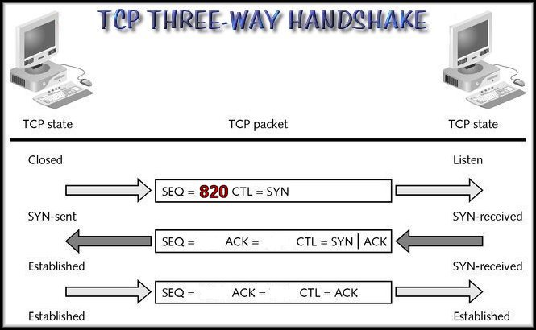
I wish to connect and here’s my first sequence number(820).
1

Slide 37
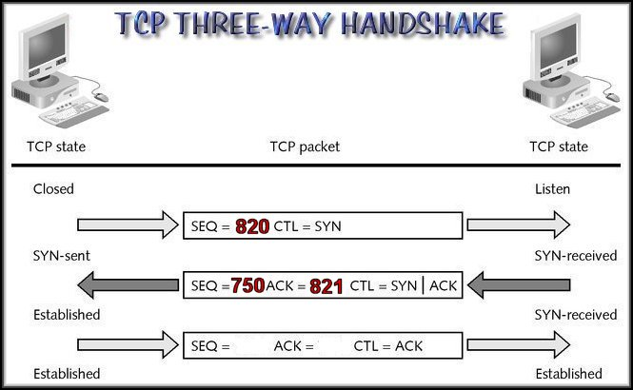
OK….Here’s my first sequence number(750). I’ve added 1 to your SEQ(820+1) as an acknowledgement. I’ll expect that to be your next sequence number(821).
1
2

Slide 38
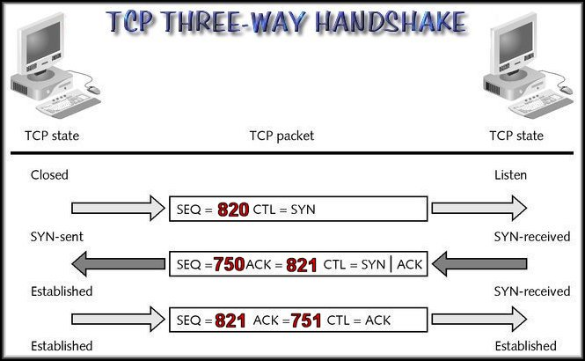
TCP Three-Way Handshake
OK….Here’s the next segment with the sequence number you expect. I’ve added 1 to your ISN to acknowledge your segment. I’ll expect that to be your next sequence number.
1
2
3

Slide 39
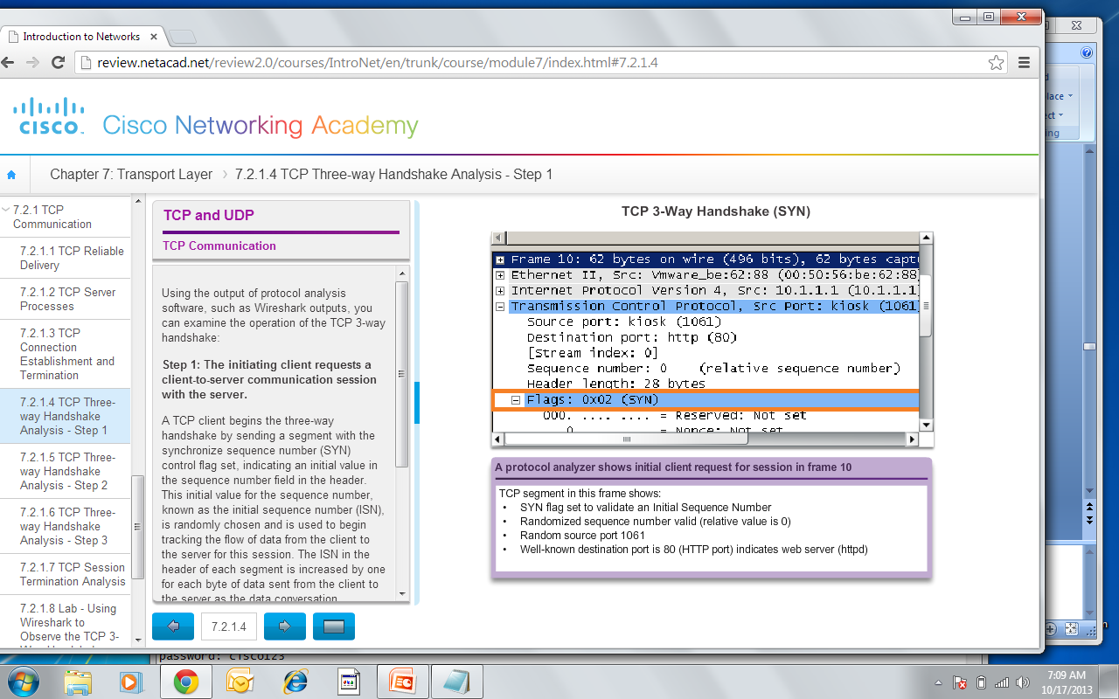
TCP Communication TCP Three-Way Handshake – Step 1
Step 1: The initiating client requests a client-to-server communication session with the server
Notes:
7.2.1.4 TCP Three Way Handshake – Step 1

Slide 40
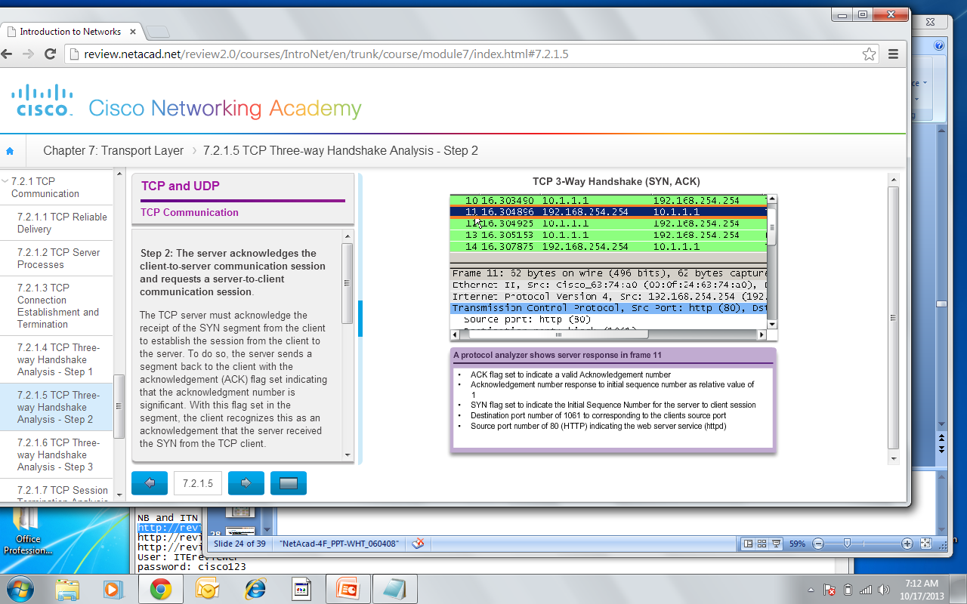
TCP Communication TCP Three-Way Handshake – Step 2
Step 2: The server acknowledges the client-to-server communication session and requests a server-to-client communication session.
Notes:
7.2.1.5 TCP Three Way Handshake – Step 2

Slide 41
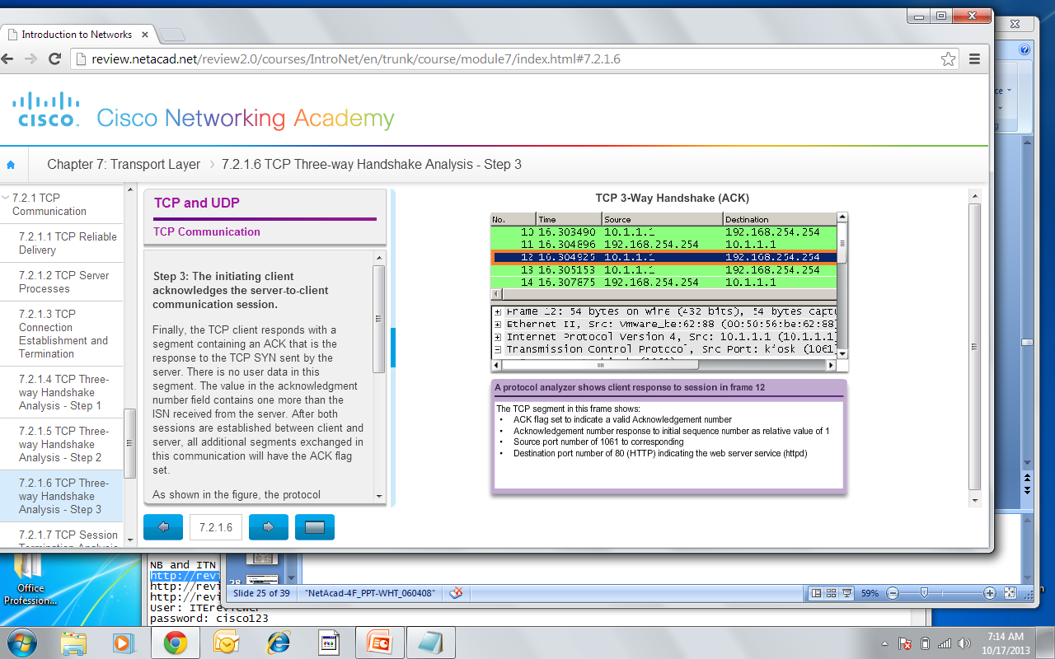
TCP Communication TCP Three-Way Handshake – Step 3
Step 3: The initiating client acknowledges the server-to-client communication session.
Notes:
7.2.1.6 TCP Three Way Handshake – Step 3

Slide 42
Topic 7.2.2: Reliability and Flow Control

Slide 43
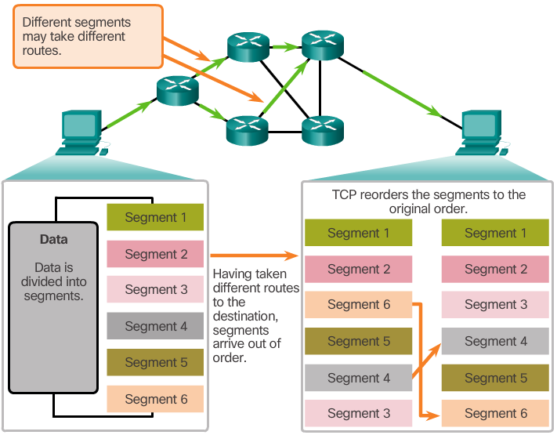
TCP Reliability – Ordered Delivery
TCP segments use sequence numbers to uniquely identify and acknowledge each segment, keep track of segment order, and indicate how to reassemble and reorder received segments.
An initial sequence number (ISN) is randomly chosen during the TCP session setup. The ISN is then incremented by the number of transmitted bytes.
The receiving TCP process buffers the segment data until all data is received and reassembled.
Segments received out of order are held for later processing.
The data is delivered to the application layer only when it has been completely received and reassembled.
Notes:
9.2.2.1 TCP Reliability – Ordered Delivery

Slide 44
TCP Reliability - Sequence Numbers and Acknowledgements
TCP is designed to confirm that each segment reached its destination.
TCP session setup ensures the destination is not only reachable, but ready to receive data.
The TCP process on the destination host acknowledges the data it has received from the source application.
TCP allows for the retransmission of missed segments.
TCP ensures all segments are properly re-ordered upon receipt.
TCP session termination allows for parties to gracefully end a TCP session when no data is to be transferred (FIN flag).
A TCP endpoint can abruptly terminate a session if necessary (RST flag).
The video on page 9.2.2.2 covers TCP Sequence Numbers and Acknowledgements.
Notes:
9.2.2.2 Video Demonstration: TCP Reliability - Sequence Numbers and Acknowledgements

Slide 45
TCP Reliability – Data Loss and Retransmission
TCP provides methods of managing segment losses.
Among these methods is a mechanism to retransmit segments for unacknowledged data.
The video on page 9.2.2.3 covers TCP retransmission.
Notes:
9.2.2.3 Video demonstration: TCP Reliability – Data Loss and Retransmission

Slide 46
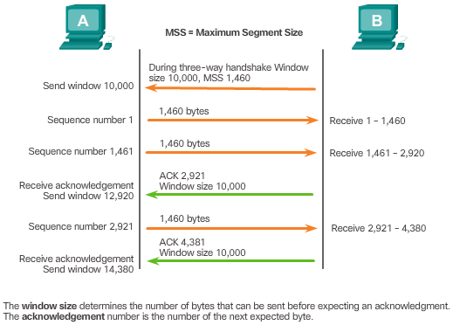
TCP Flow Control – Window Size and Acknowledgements
TCP provides mechanisms for flow control.
Flow control ensures the TCP endpoints can receive and process data reliably.
TCP handles flow control by adjusting the rate of data flow between source and destination for a given session.
TCP flow control function relies on a 16-bit TCP header field called the Window size. The window size is the number of bytes that the destination device of a TCP session can accept and process at one time.
TCP source and destination agree on the initial window size when the TCP session is established
TCP endpoints can adjust the window size during a session if necessary.
Notes:
9.2.2.4 TCP Flow Control – Window Size and Acknowledgements

Slide 47
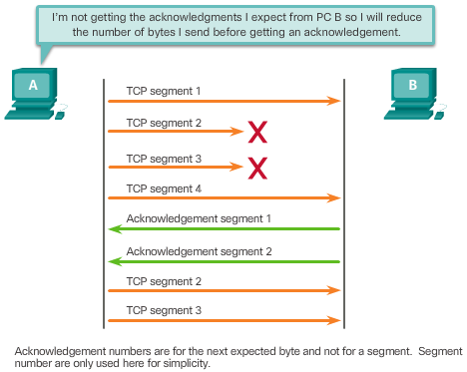
TCP Flow Control – Congestion Avoidance
Network congestion usually results in discarded packets.
Undelivered TCP segments trigger re-transmission. TCP segment retransmission can make the congestion even worse.
The source can estimate a certain level of network congestion by looking at the rate at which TCP segments are sent but not acknowledged.
The source can reduce the number of bytes it sends before receiving an acknowledgement upon congestion detection.
The source reduces the number of unacknowledged bytes it sends and not the window size, which is determined by the destination.
The destination is usually unaware of the network congestion and sees no need to suggest a new window size.
Notes:
9.2.2.5 TCP Flow Control – Congestion Avoidance

Slide 48
Topic 7.2.3: UDP Communication

Slide 49
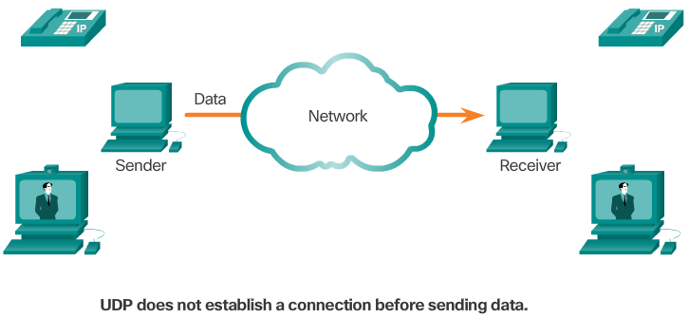
UDP Low Overhead versus Reliability
UDP is a simple protocol.
UDP provides the basic transport layer functions.
UDP has much lower overhead than TCP.
UDP is not connection-oriented and does not offer the sophisticated retransmission, sequencing, and flow control mechanisms.
Applications running UDP can still use reliability, but it must be implemented in the application layer.
However, UDP is not inferior. It is designed to be simpler and faster than TCP at the expense of reliability.
Notes:
9.2.3.1 TUDP Low Overhead versus Reliability

Slide 50
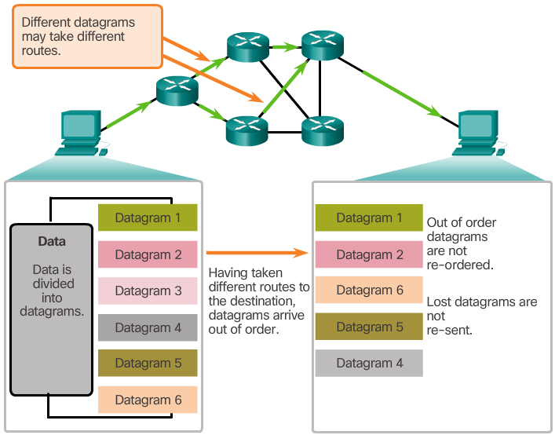
UDP Datagram Reassembly
UDP does not track sequence numbers the way TCP does.
UDP has no way to reorder the datagrams into their transmission order.
UDP simply reassembles the data in the order in which it was received.
The application must identify the proper sequence, if necessary.
Notes:
9.2.3.2 UDP Datagram Reassembly

Slide 51
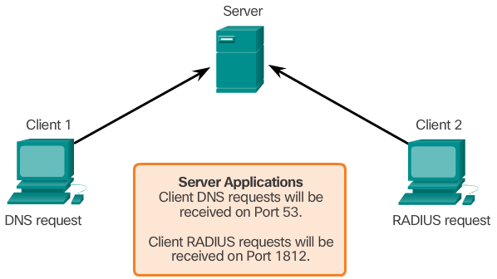
UDP Server Processes
UDP-based server applications are also assigned well-known or registered port numbers.
UDP applications and services running on a server accept UDP client requests.
Requests received on a specific port are forwarded to the proper application based on port numbers.
Notes:
9.2.3.3 UDP Server Processes

Slide 52
UDP Server Processes
UDP client-server communication is also initiated by a client application.
The UDP client process dynamically selects a port number and uses this as the source port.
The destination port is usually the well-known or registered port number assigned to the server process.
The same source-destination pair of ports is used in the header of all datagrams used in the transaction.
Data returning to the client from the server uses a flipped source and destination port numbers in the datagram header.
Notes:
9.2.3.4 UDP Client Processes
9.2.3.5 Lab – Using Wireshark to Examine a UDP DNS Capture

Slide 53
Topic 7.2.4: TCP or UDP

Slide 54
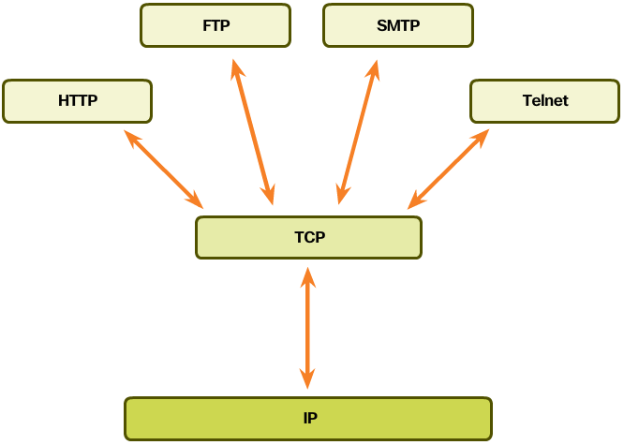
Applications that use TCP
TCP handles all transport layer related tasks.
This frees the application from having to manage any of these tasks.
Applications can simply send the data stream to the transport layer and use the services of TCP.
Notes:
9.2.4.1 Applications that use TCP

Slide 55
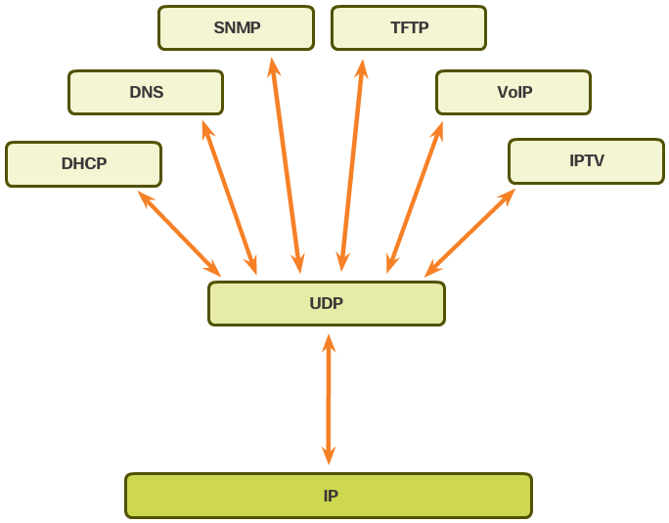
Applications that use UDP
There are three types of applications that are best suited for UDP:
Live video and multimedia applications - Can tolerate some data loss, but require little or no delay. Examples include VoIP and live streaming video.
Simple request and reply applications - Applications with simple transactions where a host sends a request and may or may not receive a reply. Examples include DNS and DHCP.
Applications that handle reliability themselves - Unidirectional communications where flow control, error detection, acknowledgements, and error recovery is not required or can be handled by the application. Examples include SNMP and TFTP.
Notes:
9.2.4.2 Applications that use UDP
9.2.4.3 Lab – Using Wireshark to Examine FTP and TFTP
9.2.4.4 Activity – TCP, UDP, or Both

Slide 56
Section 7.3: Summary
Chapter Objectives:
Explain how transport layer protocols and services support communications across data networks.
Compare the operations of transport layer protocols in supporting end-to-end communication.

